Slide 1

TCP/IP Internetworking
Chapter 8
Raymond Panko’s
Business Data Networks and Telecommunications, 7th edition
May only be used by adopters of the book
Notes:
Now that we have dealt with simpler network standards at lower layers, we can finally turn to the more complex TCP/IP standards that drive corporate networks above the level of switched networks.

Slide 2
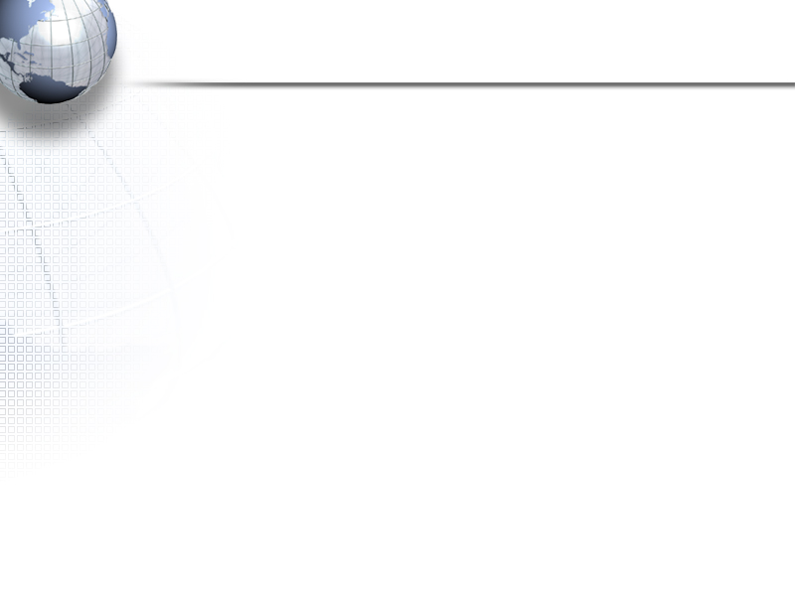
Recap
Switched Networks
  Chapters 4 and 5 covered switched LANs
  Chapters 6 and 7 covered residential Internet access and switched WANs
Internets
  Connect multiple switched networks using routers
  70%-80% of internet traffic follows TCP/IP standards
  These standards are created by the IETF
  Chapter 10 looks in more detail at TCP/IP management
Notes:
<Read the slide.>

Slide 3
Frames and Packets
Recap
Messages at the data link layer are called frames
Messages at the internet layer are called packets
Within a single network, packets are encapsulated in the data fields of frames
Frame
Trailer
Packet
(Data Field)
Frame
Header
Notes:
<Read the slide. Then go through the illustration at the bottom.>

Slide 4
Frames and Packets
Recap
In an internet with hosts separated by N networks, there will be:
  2 hosts
  One packet (going all the way between hosts)
    One route (between the two hosts)
  N frames (one in each network)
Notes:
<Read the slide.>

Slide 5
8-1: Major TCP/IP Standards
5 Application | User Applications |  |  | Supervisory Applications
 | HTTP | SMTP | Many Others | DNS | Dynamic Routing Protocols |  | Many Others
4 Transport | TCP |  |  |  | UDP
3 Internet | IP |  |  |  |  | ARP
2 Data Link | None: Use OSI Standards
1 Physical | None: Use OSI Standards
ICMP
Note: Shaded protocols are discussed in this chapter
Notes:
Note that TCP/IP has standards at the internet, transport, and application layers.
At the application layers, there are user applications such as HTTP and supervisory protocols.
We will look at the shaded protocols in this chapter.
We will see more TCP/IP application protocols in Chapter 10.
We will see more TCP supervisory protocols in Chapter 11.

Slide 6
8-2: IP, TCP, and UDP
Recap
Protocol | Layer | Connection-Oriented/ Connectionless | Reliable/ Unreliable | Lightweight/ Heavyweight
TCP | 4 (Transport) | Connection-oriented | Reliable | Heavyweight
UDP | 4 (Transport) | Connectionless | Unreliable | Lightweight
IP | 3 (Internet) | Connectionless | Unreliable | Lightweight
Notes:
<Go through the table.>

Slide 7
IP Addresses
32-Bit Strings
Dotted Decimal Notation for Human Reading
(e.g., 128.171.17.13)
Notes:
We have seen IP addresses since Chapter 1.
You know that they are strings of 32 bits (1s and 0s).
You know that they are typically expressed in dotted decimal notation for human reading.
Now you will learn that these 32 bits are organized in a particular way.

Slide 8
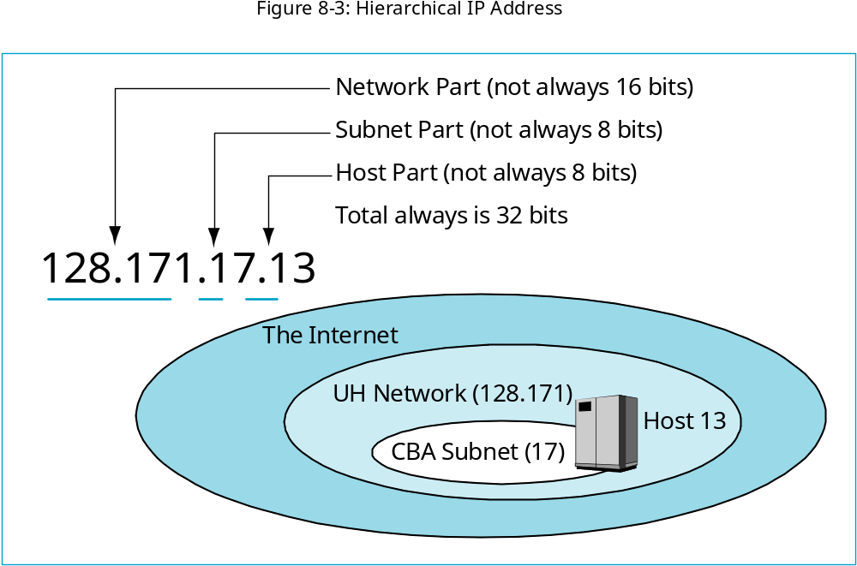
8-3: Hierarchical IP Address
IP addresses are not
simple 32-bit numbers.
They usually have 3 parts.
Consider the example
128.171.17.13
Notes:
IP addresses are not simple 32-bit numbers.
They usually have 3 parts.
Consider the example 128.171.17.13. This is a host on the University of Hawaii Network, in the College of Business Administration Subnet.
The network part, 128.171, indicates that the host is on the UH Network.
The subnet part, 17, indicates that the host is on the CBA subnet.
The host part indicates that the host is Host 13 on the CBA subnet.
IP addresses are always 32 bits long.
In this slide, the network part is16 bits, and the subnet and host parts are 8 bits each.
However, there is no standard length for the network, subnet, and host parts.
The only rule is that the total is always 32 bits.

Slide 9
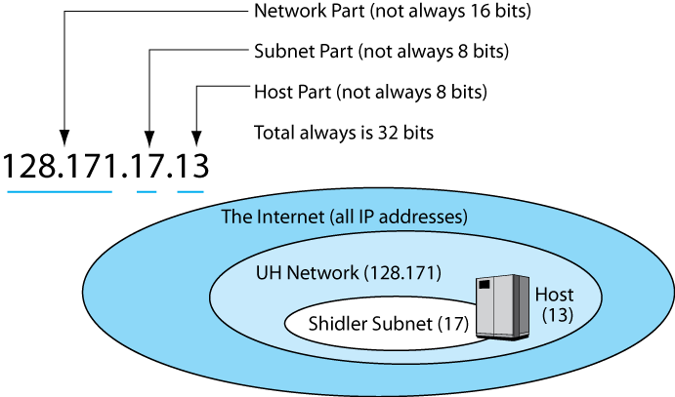
8-3: Hierarchical IP Address
In this case,
128.171 is the network part
(16 bits)
17 is the subnet part (8 bits)
13 is the host part (8 bits)
Notes:
<Read the text in the box.>

Slide 10
8-3: Hierarchical IP Address
The network part is not
always 16 bits.
And the other two parts
are not always 8 bits each.
However, the total is
always 32 bits.
Notes:
<Read the text in the box.>

Slide 11
Hierarchical Addressing
Hierarchical Addressing Brings Simplicity
  Phone System
    Country code / area code / exchange / subscriber number
    01-808-555-9889
  Long-distance switches near the top of the hierarchy only have to deal with country codes and area codes to set up circuits
  Similarly, core Internet routers only have to consider network or network and subnet parts of packets
Notes:
<Read the slide.>

Slide 12
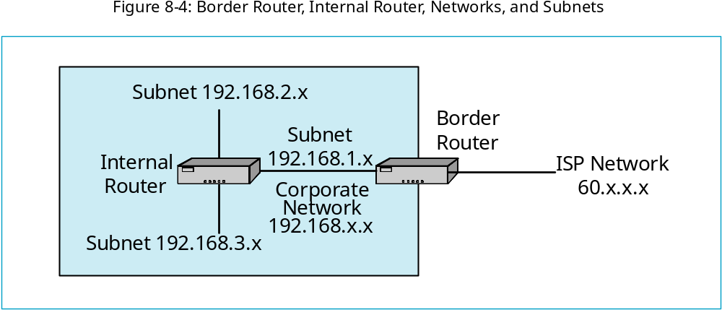
8-4: Border Router, Internal Router, Networks, and Subnets
Border routers connect different Internet networks
(In this case, 192.168.x.x and 60.x.x.x).
An “x” indicates anything.
Notes:
<Read the text box.>
<Point out the two networks—192.168.x.x and 60.x.x.x>

Slide 13
8-4: Border Router, Internal Router, Networks, and Subnets
Internal routers connect different subnets in a network.
In this case, the three subnets are boxed in red:
192.168.1.x, 192.168.2.x, and 192.168.3.x.
Notes:
<Read the text box.>
<Then point out the three subnets.>

Slide 14
Router Operation
Notes:
We looked at Ethernet switch operation early in this book because it was simple.
Router operation is much more complex.

Slide 15
8-5: IP Network and Subnet Masks
The Problem
  There is no way to tell by looking at an IP address what sizes the network, subnet, and host parts are—only their total of 32 bits
  The solution: masks
Notes:
<Read the slide.>

Slide 16
8-5: IP Network and Subnet Masks
Masking
  A mask is a series of initial ones followed by series of final zeros for a total of 32 bits
    Example: 255.255.0.0 is 16 ones followed by 16 zeros
    In prefix notation, /16
    (Decimal 0 is 8 zeros and Decimal 255 is 8 ones)
Notes:
<Read the slide.>

Slide 17
8-5: IP Network and Subnet Masks
Masking
  Result: IP address where mask bits are ones and zeros where the mask bits are zero
IP Address Bit
1
0
1
1
1
0
1
1
Mask Bit
1
1
1
1
0
0
0
0
Result
1
0
1
1
0
0
0
0
Notes:
<Read the slide.>
<Walk the students through the example shown in the boxes.>

Slide 18
8-5: IP Network and Subnet Masks
Masking
  Eight 0s is 0
  Eight 1s is 255
IP Address Octet
128
171
17
13
Mask Octet
255
255
0
0
Result
128
171
0
0
Notes:
<Read the slide.>
<Walk the students through the example shown in the boxes.>

Slide 19
8-5: IP Network and Subnet Masks
Network Masks
  Have 1s for the network part
  Have zeros for the subnet and host parts
  If network part is 14, there are 14 ones and 18 zeros
Subnet Masks
  Have 1s for the network and subnet parts
  Have zeros for the host part
Notes:
<Read the slide.>

Slide 20
8-5: IP Network and Subnet Masks
Mask Operation
Network Mask | Dotted Decimal Notation
Destination IP Address | 128.171.17.13
Network Mask | 255.255. 0. 0
Bits in network part, followed by zeros | 128.171. 0 .0
Subnet Mask | Dotted Decimal Notation
Destination IP Address | 128.171. 17.13
Subnet Mask | 255.255.255. 0
Bits in network part and subnet parts, followed by zeros | 128.171. 17. 0
Notes:
<Walk the student through the examples.>

Slide 21
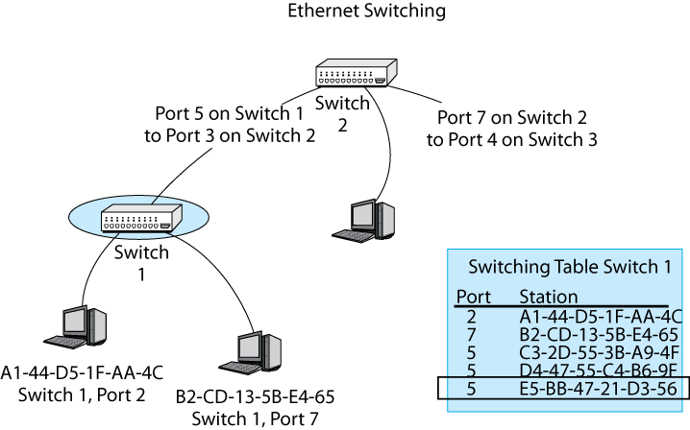
8-6: Ethernet Switching Versus IP Routing
Destination address is E5-BB-47-21-D3-56.
Ethernet switches are arranged in a hierarchy.
So there is only one possible path between hosts.
So only one row can match an Ethernet address.
Finding this row is very simple and fast.
So Ethernet switching is inexpensive per frame handled.
Frame to
E5-…
One correct row
Notes:
<Read the text in the box.>
<Point out the single row that matches the destination IP address, E5-BB-47-21-D3-56.>

Slide 22
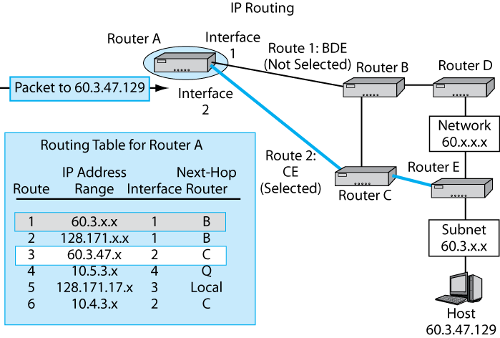
8-6: Ethernet Switching Versus IP Routing
Route 3:
CE
(Selected)
Because of multiple alternative routes in router meshes,
routers may have several rows that match an IP address.
Routers must find All matches and then select the BEST ONE.
This is slow and therefore expensive compared to switching.
Notes:
<Read the text in the box.>
<Point out the two direct rows.>
<Trace the two routes. Count the number of hops for each.>
<Ask which is the better route?>
[Note, in the book, there is an error. Next to the blue arrow, Route 3 is marked as Route 2 in the book.]

Slide 23
8-7: The Routing Process
Routing
  Processing an individual packet and passing it on its way is called routing
The Routing Table
  Each router has a routing table that it uses to make routing decisions
  Routing Table Rows
    Each row represents a route for a range of IP addresses—often packets going to the same a network or subnet
Notes:
<Read the slide.>

Slide 24
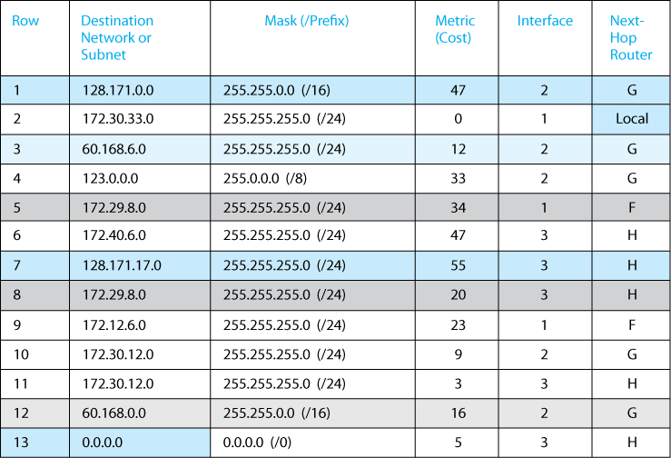
8-8: Routing Table
Each row represents a route
For a group of IP addresses
For Row 1, the address range
Is 128.171.0.0 to 128.171.255.255
Notes:
<Read the text box.>
<Walk the students through the area marked in red.>
<You can ask them to prove that the address range for Row 1 is 128.171.0.0 to 128.171.255.255.>

Slide 25
8-7: The Routing Process
A Routing Decision
  Step 1: Finding All Row Matches
    The router looks at the destination IP address in an arriving packet
    For each row:
      Apply the row’s mask to the destination IP address in the packet
      Compare the result with the row’s destination value
      If the two match, the row is a match
Notes:
<Read the slide.>

Slide 26
8-7: The Routing Process
A Routing Decision
  Step 1: Finding All Row Matches
    Example 1: A Destination IP Address that is in NOT the Range
      Destination IP Address of Arriving Packet 60.43.7.8
      Apply the (Network) Mask 255.255.0.0
      Result of Masking 60.43.0.0
      Destination Column Value 128.171.0.0
      Destination Matches the Masking Result? No
      Conclusion Not a match
Notes:
<Read the slide.>

Slide 27
8-7: The Routing Process
A Routing Decision
  Step 1: Finding All Row Matches
    Example 2: A Destination IP Address that is in the Range
      Destination IP Address of Arriving Packet 128.171.17.13
      Apply the Mask 255.255.0.0
      Result of Masking 128.171.0.0
      Destination Column Value 128.171.0.0
      Destination Matches the Masking Result? Yes
      Conclusion Row is a match
Notes:
<Read the slide.>

Slide 28
8-7: The Routing Process
A Routing Decision
  Step 1: Finding All Row Matches
    The router do this to ALL rows because there may be multiple matches
    This step ends with a set of matching rows
Notes:
<Read the slide.>
<Ask, “If two rows match the destination IP address in the arriving packet, how many rows will the router test to see if they are matches? The answer: ALL rows.

Slide 29
8-7: The Routing Process
A Routing Decision
  Step 2: Find the Best-Match Row
    The router examines the matching rows it found in Step 1 to find the best-match row
    Tie Breaker 1: It selects the row with the longest match (Initial 1s in the row mask)
    Tie Breaker 2: If there is a tie on longest match, select among the tie rows based on metric
      For cost metric, choose the row with the lowest metric value
      For speed metric, choose the row with the highest metric value
Notes:
<Read the slide.>

Slide 30
8-7: The Routing Process
A Routing Decision
  Step 3: Send the Packet Back Out
    Send the packet out the interface (router port) designated in the best-match row
    Address the packet to the IP address in the next-hop router column
      If the address says Local, the destination host is out that interface
      Sends the packet to the destination IP address in a frame
Notes:
<Read the slide.>

Slide 31
8-7: The Routing Process
Recap: Steps for Each Arriving Packet:
  1. Test all rows for matches and find all matching rows
  2. Find the best-match row
    Length of match
    If same length of match, turn to metric value
  3. Send the packet out through the indicated interface to the indicated device
Repeat the entire process of the next Packet
  Even if it going to the same IP address
Notes:
<Read the slide.>

Slide 32
The Address Resolution Protocol (ARP)
Notes:
Now we come to the address resolution protocol, ARP.
ARP has a simple purpose but is a bit difficult to understand because it mixes data link layer and internet layer concepts.

Slide 33
The Address Resolution Protocol (ARP)
The Problem
  When a packet arrives, the router knows the IP address of the device to which it will send the packet
    A next-hop router or the destination host
  The router must place this packet in a frame and send it to the device
  The router must know the data link layer address of the destination device in order to send it the frame
  Finding the data link layer destination address is address resolution
Notes:
<Read the slide.>

Slide 34
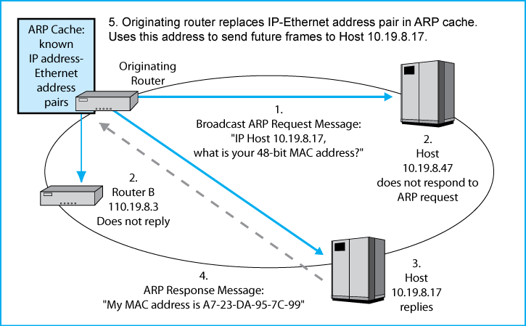
8-9: Address Resolution Protocol (ARP)
The Situation:
The router wishes to pass the packet to the
destination host or to a next-hop router.
The router knows the destination IP address of the target.
The router must learn the target’s MAC layer address
in order to be able to send the packet to the target in a frame.
(Otherwise, it has no way to address the frame.)
The router uses the Address Resolution Protocol (ARP)
Notes:
<Read the text box.>

Slide 35
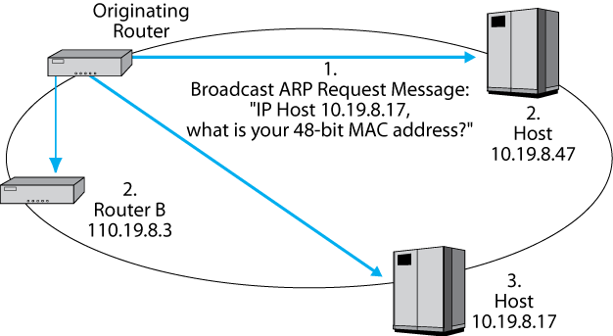
8-9: Address Resolution Protocol (ARP)
The router broadcasts an ARP Request Message
to all IP addresses.
Notes:
<Read the text box.>

Slide 36
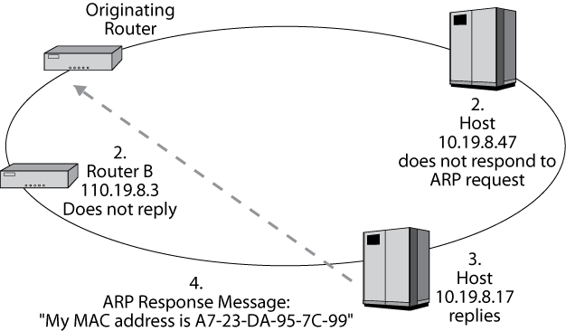
8-9: Address Resolution Protocol (ARP)
Only the host with the specified
IP address replies.
Notes:
<Read the text box.>

Slide 37
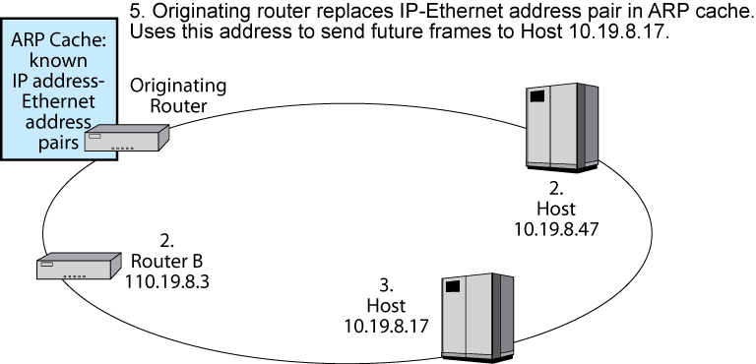
8-9: Address Resolution Protocol (ARP)
The router caches the data link
Layer address for 10.19.8.17
Notes:
<Read the text box and the top text in the slide.>

Slide 38
The Internet Protocol (IP)
Versions 4 and 6
Notes:
We have seen the Internet Protocol (IP) several times already in this book. Now we will see it in more depth.
We will look at two versions of IP—Version 4 and Version 6.
<If you can, hand out Figure 8-10.>

Slide 39
8-10: IPv4 and IPv6 Packets
Bit 0
IP Version 4 Packet
Bit 31
Version
(4 bits)
Value
is 4
(0100)
Header
Length
(4 bits)
Diff-Serv
(8 bits)
Total Length
(16 bits)
Length in octets
Identification (16 bits)
Unique value in each original
IP packet
Flags
(3 bits)
Fragment Offset (13 bits)
Octets from start of
original IP fragment’s
data field
IPv4 is the dominant version of IP today.
The version number in its header is 4 (0100).
The header length and total length field tell the size of the packet.
The Diff-Serv field can be used for quality of service labeling.
(But MPLS is being used instead by most carriers)
Time to Live
(8 bits)
Protocol (8 bits)
1=ICMP, 6=TCP,
17=UDP
Header Checksum
(16 bits)
Notes:
<Read the text box.>

Slide 40
8-10: IPv4 and IPv6 Packets
Bit 0
The second row is used for reassembling fragmented
IP packets, but fragmentation is quite rare,
so we will not look at these fields.
IP Version 4 Packet
Bit 31
Version
(4 bits)
Value
is 4
(0100)
Header
Length
(4 bits)
Diff-Serv
(8 bits)
Total Length
(16 bits)
Length in octets
Identification (16 bits)
Unique value in each original
IP packet
Flags
(3 bits)
Fragment Offset (13 bits)
Octets from start of
original IP fragment’s
data field
Time to Live
(8 bits)
Protocol (8 bits)
1=ICMP, 6=TCP,
17=UDP
Header Checksum
(16 bits)
Notes:
<Read the text box.>

Slide 41
8-10: IPv4 and IPv6 Packets
The sender sets the time-to-live value (usually 64 to 128).
Each router along the way decreases the value by one.
A router decreasing the value to zero discards the packet.
It may send an ICMP error message.
The protocol field describes the message in the data field
(1=ICMP, 2=TCP, 3=UDP, etc.)
The header checksum is used to find errors in the header.
If a packet has an error, the router drops it.
There is no retransmission at the internet layer,
so the internet layer is still unreliable.
Bit 0
IP Version 4 Packet
Bit 31
Version
(4 bits)
Value
is 4
(0100)
Header
Length
(4 bits)
Diff-Serv
(8 bits)
Total Length
(16 bits)
Length in octets
Identification (16 bits)
Unique value in each original
IP packet
Flags
(3 bits)
Fragment Offset (13 bits)
Octets from start of
original IP fragment’s
data field
Time to Live
(8 bits)
Protocol (8 bits)
1=ICMP, 6=TCP,
17=UDP
Header Checksum
(16 bits)
Notes:
<Read the text box.>

Slide 42
8-10: IPv4 and IPv6 Packets
Bit 0
IP Version 4 Packet
Bit 31
Source IP Address (32 bits)
Destination IP Address (32 bits)
Options (if any)
Padding
Data Field
The source and destination IP addresses
Are 32 bits long, as you would expect.
Options can be added, but these are rare.
Notes:
<Read the text box.>

Slide 43
8-10: IPv4 and IPv6 Packets
IP Version 6 is the emerging
version of the Internet protocol.
Has 128 bit addresses for
an almost unlimited number of IP addresses.
Needed because of rapid growth in Asia.
Also needed because of the exploding
number of mobile devices.
Bit 0
IP Version 6 Packet
Bit 31
Version
(4 bits)
Value
is 6
(0110)
Diff-Serv
(8 bits)
Flow Label (20 bits)
Marks a packet as part of a specific flow
Payload Length
(16 bits)
Next Header
(8 bits) Name
of next header
Hop Limit
(8 bits)
Source IP Address (128 bits)
Destination IP Address (128 bits)
Next Header or Payload (Data Field)
Notes:
<Read the text box.>

Slide 44
The Transmission Control Protocol (TCP)
Notes:
Now we will look in more detail at TCP.
<If you can, hand out Figure 8-11.>

Slide 45
8-11: TCP Segment and UDP Datagram
Bit 0
TCP Segment
Bit 31
Source Port Number (16 bits)
Destination Port Number (16 bits)
Sequence Number (32 bits)
Acknowledgment Number (32 bits)
The source and destination port numbers
specify a particular application on the
source and destination multitasking computers
(Discussed later).
Sequence numbers are 32 bits long.
So are acknowledgment numbers.
Header
Length
(4 bits)
Reserved
(6 bits)
Flag Fields
(6 bits)
Window Size
(16 bits)
TCP Checksum (16 bits)
Urgent Pointer (16 bits)
Flag fields are one-bit fields. They include SYN, ACK, FIN,
and RST.
Notes:
<Read the text box.>

Slide 46
8-11: TCP Segment and UDP Datagram
Flags are one-bit fields.
If a flag’s value is 1, it is “set”.
If a flag’s value is 0, it is “not set.”
TCP has six flags.
If the TCP Checksum field’s value is correct,
The receiving process sends back an acknowledgment.
Bit 0
TCP Segment
Bit 31
Source Port Number (16 bits)
Destination Port Number (16 bits)
Sequence Number (32 bits)
Acknowledgment Number (32 bits)
Header
Length
(4 bits)
Reserved
(6 bits)
Flag Fields
(6 bits)
Window Size
(16 bits)
TCP Checksum (16 bits)
Urgent Pointer (16 bits)
Notes:
<Read the text box.>

Slide 47
8-11: TCP Segment and UDP Datagram
For flow control (to tell the other party to slow down),
The sender places a small value in the Window Size field.
If the Window Size is small, the receiver will have to stop transmitting
after a few more segments (unless it gets a new acknowledgment
extending the number of segments it may send.)
Bit 0
TCP Segment
Bit 31
Source Port Number (16 bits)
Destination Port Number (16 bits)
Sequence Number (32 bits)
Acknowledgment Number (32 bits)
Header
Length
(4 bits)
Reserved
(6 bits)
Flag Fields
(6 bits)
Window Size
(16 bits)
TCP Checksum (16 bits)
Urgent Pointer (16 bits)
Notes:
<Read the text box.>

Slide 48
8-11: TCP Segment and UDP Datagram
Bit 0
TCP Segment
Bit 31
Options (if any)
Padding
Data Field
TCP segment headers can end with options.
Unlike IPv4 options,
TCP options are very common.
If an option does not end at a 32-bit boundary,
padding must be added.
Notes:
<Read the text box.>

Slide 49
8-12: TCP Session Openings and Closings
Normal Three-Way Opening
SYN
SYN/ACK
ACK
A SYN segment is a segment in which the SYN bit is set.
One side sends a SYN segment requesting an opening.
The other side sends a SYN/acknowledgment segment.
Originating side acknowledges the SYN/ACK.
Notes:
<Read the text box.>

Slide 50
8-12: TCP Session Openings and Closings
Normal Four-Way Close
FIN
ACK
FIN
ACK
A FIN segment is a segment in which the FIN bit is set.
Like both sides saying “good bye” to end a conversation.
Notes:
<Read the text box.>

Slide 51
8-12: TCP Session Openings and Closings
Abrupt Reset
RST
An RST segment is a segment in which the RST bit is set.
A single RST segment breaks a connection.
Like hanging up during a phone call.
There is no acknowledgment.
Notes:
<Read the text box.>

Slide 52
The User Datagram Protocol (UDP)
Notes:
Now we will take a closer look at UDP.

Slide 53
8-11: TCP Segment and UDP Datagram
Bit 0
UDP Datagram
Bit 31
Source Port Number (16 bits)
Destination Port Number (16 bits)
UDP Length (16 bits)
UDP Checksum (16 bits)
Data Field
UDP messages (datagrams) are very simple.
Like TCP, UDP has 16-bit port numbers.
The UDP length field allows variable-length application messages.
If the UDP checksum is correct, there is no acknowledgment.
If the UDP checksum is incorrect, the UDP datagram is dropped.
Notes:
<Read the text box.>

Slide 54
Port Numbers and Sockets in TCP and UDP
Notes:
Now we come to two related topics that are heavily used by anyone working with TCP/IP. These are port numbers and sockets.

Slide 55

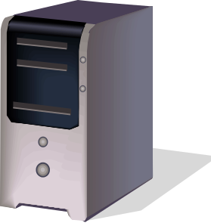
TCP and UDP Port Numbers
Computers are multitasking devices
  They run multiple applications at the same time
  On a server, a port number designates a specific application
HTTP Webserver
Application
SMTP E-Mail
Applications
Port 80
Port 25
Server
Notes:
<Read the slide.>

Slide 56
TCP and UDP Port Numbers
Major Applications Have Well-Known Port Numbers
  0 to 1023 for both TCP and UDP
  HTTP is TCP Port 80
  SMTP is TCP Port 25
SMTP E-Mail
Application
HTTP Webserver
Application
Port 80
Port 25
Server
Notes:
<Read the slide.>

Slide 57

TCP and UDP Port Numbers
Clients Use Ephemeral Port Numbers
  1024 to 4999 for Windows Client PCs
  A client has a separate port number for each connection to a program on a server
E-Mail
Application
on Mail
Server
Webserver
Application
on Webserver
Port 4400
Port 3270
Client
Notes:
<Read the slide.>

Slide 58

TCP and UDP Port Numbers
A socket is an
IP address, a colon, and a port number.
1.33.17.3:80
123.30.17.120:25
128.171.17.13:2849
It represents a specific application (Port number)
on a specific server (IP address)
Or a specific connection on a client.
Client 60.171.18.22
Webserver
1.33.17.13
Port 80
Client PC
128.171.17.13
Port 2849
SMTP Server
123.30.17.120
Port 25
Notes:
<Read the text box.>

Slide 59
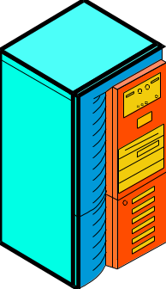
8-13: Use of TCP (and UDP) Port Numbers
Client
60.171.18.22
Source: 60.171.18.22:2707
Destination: 1.33.17.13:80
This shows sockets for a client
packet sent to a webserver application
on a webserver
Webserver
1.33.17.13
Port 80
SMTP Server
123.30.17.120
Port 25
Notes:
<Read the yellow text box.>
<Read the blue box.>

Slide 60
8-13: Use of TCP (and UDP) Port Numbers
Client
60.171.18.22
Source: 60.171.18.22:2707
Destination: 1.33.17.13:80
Source: 1.33.17.13:80
Destination: 60.171.18.22:2707
Webserver
1.33.17.13
Port 80
Sockets in
two-way
transmission
SMTP Server
123.30.17.120
Port 25
Notes:
<Read the yellow text box.>
<Read the blue boxes.>

Slide 61
8-13: Use of TCP (and UDP) Port Numbers
Client
60.171.18.22
Source: 60.171.18.22:2707
Destination: 1.33.17.13:80
Source: 1.33.17.13:80
Destination: 60.171.18.22:2707
Webserver
1.33.17.13
Port 80
Source: 60.171.18.22:4400
Destination: 123.30.17.120:25
SMTP Server
123.30.17.120
Port 25
Clients use a different ephemeral
port number for different connections
Notes:
<Read the yellow text box.>
<Read the pink box.>

Slide 62

Dynamic Routing Protocols
Dynamic Routing Protocol
Routing Table Information
Notes:
How do the routers get the information for their routing tables?
The answer is that they constantly share route information using dynamic routing protocols.
<You might add that this is like students sharing what they know about courses and professors.>

Slide 63

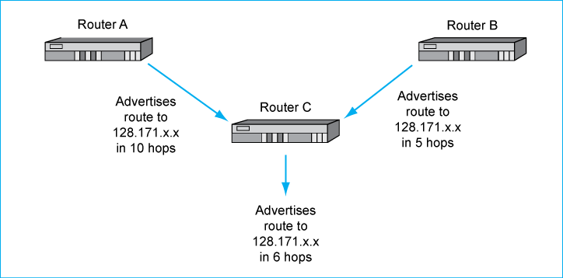
Dynamic Routing Protocols
1
Here is a simple
example of how a
dynamic routing
protocol works.
Here, the metric is
the number of hops
to the destination IP
addresses, 128.171.x.x
Notes:
<Read the left and right text boxes.>
Router A and Router B tell Router C how many hops they need to deliver packets to 128.171.x.x.
Router B is better for delivery because it can get the packet delivered in fewer hops.
If a packet going to 128.171.17.13 arrives at Router A, Router A will send it on to Router B
Router C announces that it can deliver packets going to 128.171.x.x in six hops
(Via Router B)
[Most dynamic routing protocols provide more information than the number of hops to a group of IP addresses.
For instance, they may give the cost to deliver the packet by different routes.
They may also consider interface speed, interface congestion, and other factors.
Different dynamic routing protocols have different metrics to describe possible routes.]

Slide 64
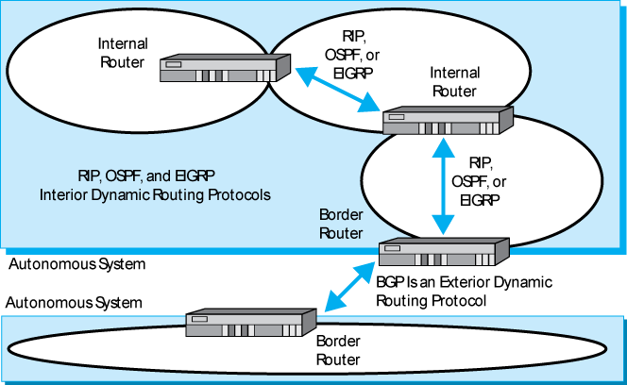
8-15: Dynamic Routing Protocols: Interior and Exterior
1
Large organizations and
ISPs are autonomous systems.
Autonomous systems can
Select their interior
Dynamic routing protocols.
When they talk to other
Autonomous systems, they
Must negotiate which
Exterior DRP they will use.
Notes:
<Read the two text boxes.>

Slide 65
8-14: Dynamic Routing Protocols
Dynamic Routing Protocol | Interior or Exterior Routing Protocol? | Remarks
RIP (Routing Information Protocol) | Interior | Only for small autonomous TCP/IP systems with low needs for security
OSPF (Open Shortest Path First) | Interior | For large autonomous systems that only use TCP/IP
EIGRP (Enhanced Interior Gateway Routing Protocol) | Interior | Proprietary Cisco Systems protocol. Not limited to TCP/IP routing. Also handles IPX/SPX, SNA, and so forth
BGP (Border Gateway Protocol) | Exterior | Organization cannot choose what exterior routing protocol it will use. TCP/IP protocol
Notes:
<Read through the table.>
<Note that EIGRP is only used in networks with Cisco routers and that EIGRP is not limited to supporting TCP/IP routing.>
<Note that BPG is the only exterior routing protocol.>

Slide 66
The Internet Control Message Protocol (ICMP)
Notes:
Another important supervisory protocol in TCP/IP is the Internet Control Message Protocol, ICMP.

Slide 67
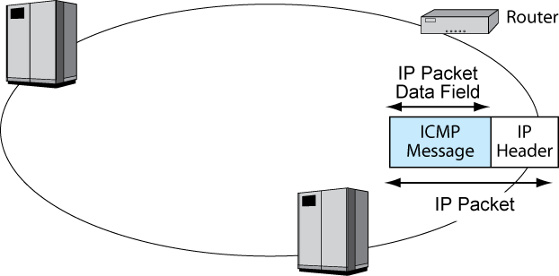
8-16: Internet Control Message Protocol (ICMP) for Supervisory Messages
ICMP is the internet layer
supervisory protocol.
ICMP messages are encapsulated
in the data field of IP packets.
These packets have no
higher-layer contents.
Notes:
<Read the text box. Go through the red-boxed information.>

Slide 68
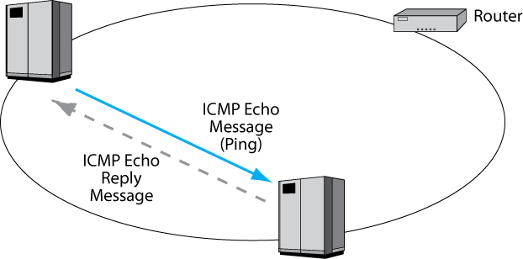
8-16: Internet Control Message Protocol (ICMP) for Supervisory Messages
1
Pinging a host sends it
an ICMP echo message.
When the host receives
this ping, it sends back.
An echo reply message.
pinging is a quick way to
learn if a host is available.
At the Windows command line,
Type “ping <IPaddress>[Enter]”
Notes:
<Read the text boxes.>

Slide 69
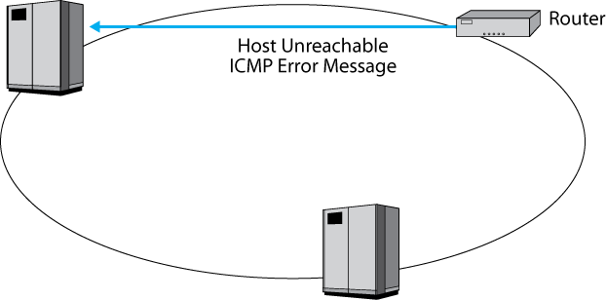
8-16: Internet Control Message Protocol (ICMP) for Supervisory Messages
If a router cannot deliver a packet,
it may send an ICMP error
message to the source host.
There are several types of
ICMP messages, for
different types of error.
Notes:
<Read the text in the box.>

Slide 70
Dynamic Host Configuration Protocol (DHCP)
From Chapter 1
Notes:
We saw DHCP in Chapter 1.
At that time, we saw that DHCP gives each computer an IP address when it first uses an internet.
Now we will see that it gives more information, which we could not discuss until this point in the book.

Slide 71
Dynamic Host Configuration Protocol
Every Host Must Have a Unique IP address
  Server hosts are given static IP addresses (unchanging)
  Clients get dynamic (temporary) IP addresses that may be different each time they use an internet
Dynamic Host Configuration Protocol (DHCP)
  Clients get these dynamic IP addresses from Dynamic Host Configuration Protocol (DHCP) servers
Notes:
Copyright 2005 Prentice-Hall
<Read the slide.>

Slide 72
8-17: Dynamic Host Configuration Protocol (DHCP)
Pool of
IP Addresses
Client PC
A3-4E-CD-59-28-7F
DHCP
Server
DHCP Request Message:
“My 48-bit Ethernet address is A3-4E-CD-59-28-7F”.
Please give me a 32-bit IP address.”
Notes:
Copyright 2005 Prentice-Hall
<Read the text toward the bottom.>
<Show how the message travels in the figure.>

Slide 73
8-17: Dynamic Host Configuration Protocol (DHCP)
Pool of
IP Addresses
Client PC
A3-4E-CD-59-28-7F
DHCP
Server
DHCP Response Message:
“Computer at A3-4E-CD-59-28-7F,
your 32-bit IP address is 11010000101111101010101100000010”.
(Usually other configuration parameters as well.)
Notes:
Copyright 2005 Prentice-Hall
<Read the text toward the bottom.>
<Show how the message travels in the figure.>

Slide 74
Why DHCP?
If You Give PCs Static Information,
  The cost of manual entry of configuration information (subnet mask, default router, DNS servers, etc.) is high
  If something changes, such as the IP address of your DNS server, the cost of manually reconfiguring each PC is high
  If something changes, your PCs may be inoperable until you make the manual changes
With DHCP, users get hot fresh configuration data automatically
Notes:
<Read the text slide.>

Slide 75
Layer 3 Switches
Notes:
Many companies are beginning to use something called Layer 3 switches.
Unfortunately, the term “Layer 3” switch is misleading.

Slide 76
Layer 3 Switches
Traditionally, switches were fast and inexpensive while routers were slow and expensive
Using special-purpose hardware called application-specific integrated circuits (ASICs) allowed the creation of limited but fast and inexpensive routers
Marketing called these limited routers “Layer 3 switches” to indicate their speed, despite the fact that they are routers and operate at Layer 3, while switches operate at Layer 2
Notes:
<Read the slide.>

Slide 77
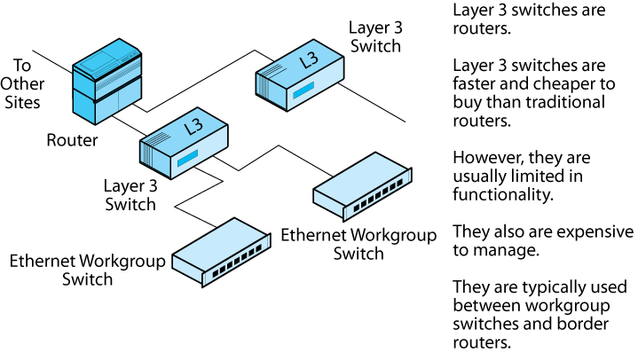
8-18: Layer 3 Switches and Routers in Site Internets
Again, Layer 3 switches are true routers,
Not switches.
However, they are faster and cheaper
than traditional routers, at least to purchase.
Notes:
<Read the text box.>

Slide 78
8-18: Layer 3 Switches and Routers in Site Internets
However, they have limited functionality
that typically makes them unsuitable to being
border routers to connect to different sites.
Notes:
<Read the text box.>

Slide 79
8-18: Layer 3 Switches and Routers in Site Internets
As routers, however, they are expensive to
manage (as we will see in Chapter 10).
After all, they really are routers, not switches.
Notes:
<Read the text box.>

Slide 80
8-18: Layer 3 Switches and Routers in Site Internets
Too limited to be border routers and
too expensive to manage to replace,
Ethernet workgroup switches, L3 switches,
typically are used between the two.
Notes:
<Read the text box.>

Slide 81
Topics Covered

Slide 82
Topics Covered
Internetworking Recap from Earlier Chapters
  Internetworking involves the internet and transport layers
  Packets are encapsulated in frames in single switched networks
  Transport layer is end-to-end
  Internet layer is hop-by-hop between routers
  IP, TCP, and UDP are the heart of TCP/IP internetworking

Slide 83
Topics Covered
Hierarchical IP Address parts
  Network, subnet, and host parts
  Part sizes vary
  Do not get hung up on the UH example, in which the three parts are 16 bits, 8 bits, and 8 bits, respectively

Slide 84
Topics Covered
Router Operation
  Border routers connect networks
  Internal routers connect subnets
  Router meshes give alternative routes, making routing decisions for incoming packets expensive

Slide 85
Topics Covered
Masks
  A mask is 32 bits long
    If it is a network mask there are 1s in the network part
    If it is a subnet mask, there are 1s in the network and subnet parts
    Remaining bits are 0s
  Applying a mask to an IP address gives the bits of the address where the mask bits are ones and zeros where the mask bits are zero

Slide 86
Topics Covered
Routing of Packets
    Routing tables
    IP address range governed by a row—usually a route to a network or subnet
    IP address range is specified by a destination and a mask
    Metric to help select best matches
    Next-hop router to be sent the packet next
      Can be a local host on one of the router’s subnets

Slide 87
Topics Covered
The Routing Process
  1. Find all possible routes through row matching
    Mask the destination IP address in the packet with the row’s mask
    Compare the result with the destination value in the row
    If they are equal, the row is a match
  2. Select the best-match row by length of match, then metric if there is a tie for length of match
  3. Send out to next hop router or destination row out the indicated interface in the best-match row

Slide 88
Topics Covered
Address Resolution Protocol
  Router knows the IP address of the next-hop router or destination host
  Must learn the data link layer address as well
  ARP makes this possible

Slide 89
Topics Covered
The Internet Protocol (IP)
  Detailed look at key fields
  Protocol field lists contents of the data field
  32-bit IP addresses
  IPv4 is the current version
  IPv6 offers 128-bit IP addresses to allow many more IP addresses to serve the world

Slide 90
Topics Covered
The Transmission Control Protocol (TCP)
  Sequence and acknowledgement numbers
  Flag fields that are set or not set
  Options are common
  Three-way openings (SYN, SYN/ACK, and ACK)
  Four-way normal closings (FIN, ACK, FIN, ACK)
  One-way abrupt closing (RST)

Slide 91
Topics Covered
The User Datagram Protocol (UDP)
  Simple four-field header
  Unreliable, connectionless
Port Numbers and Sockets in TCP and UDP
  Applications get well-known port numbers on servers
  Connections get ephemeral port numbers on clients
  Socket is an IP address, a colon, and a port number
  This designates a specific application (or connection) on a specific server (or client)

Slide 92
Topics Covered
Dynamic Routing Protocols
    Autonomous systems are large organizations or ISPs
    Interior dynamic routing protocols within an autonomous system
      RIP, OSPF, EIGRP
    Exterior dynamic routing protocols between autonomous systems
      BGP

Slide 93
Topics Covered
Internet Control Message Protocol (ICMP)
  General supervisory protocol at the internet layer
  Error advisements and Pings (echo requests/replies)
  ICMP messages are encapsulated in the data fields of IP packets

Slide 94
Topics Covered
Dynamic Host Configuration Protocol (DHCP)
  When a client PC boots up, a DHCP server sends it configuration information—an IP address, a subnet mask, and IP addresses for the default router and DNS servers
  Cheaper than configuring (and reconfiguring) client PCs manually
  Servers get static IP addresses so that clients can find them

Slide 95
Topics Covered
Layer 3 Switches
  Fast, inexpensive to buy, and limited routers
  Limited functionality and high management cost typically cause them to be used between workgroup switches and border routers

Slide 96

All rights reserved. No part of this publication may be reproduced, stored in a retrieval system, or transmitted, in any form or by any means, electronic, mechanical, photocopying, recording, or otherwise, without the prior written permission of the publisher. Printed in the United States of America.
Copyright © 2009 Pearson Education, Inc.
Publishing as Prentice Hall

